Slide 1



Vivek Raghuram (CEO)
Shailee Samar (CMO)

Slide 2
$

Slide 3


Slide 4
HIRING
HELP WANTED
JOBS AVAILABLE
We’re
HIRING
hiring
Jobs available
NOW HIRING
NOW HIRING

Slide 5

LONG COMMUTE
LONG HOURS
Too much competition
No
teens
HIGH SKILL
Poor wages
EXPERIENCE REQUIRED
NO TEENS

Slide 6










Slide 7


Slide 8


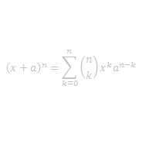
$${\left(x+a\right)}^{n}=\sum_{k=0}^{n}{\left({n \atop k}\right)x^{k}a^{n−k}}$$
Part-time jobs
& Internships
Tutoring
& Coaching
Micro-jobs

Slide 9


Slide 10
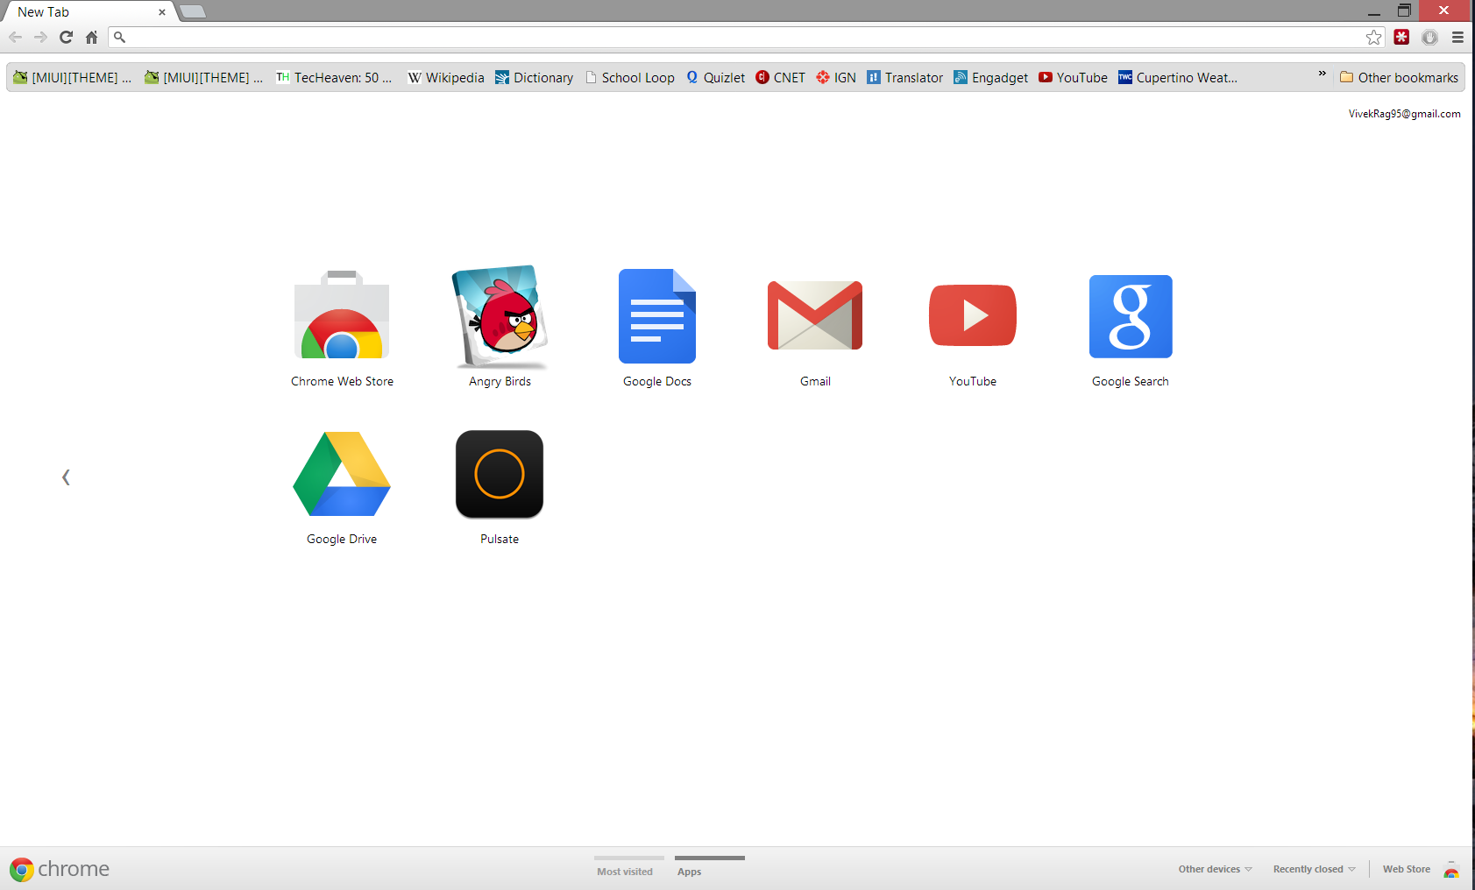




e
e
n
g
u
r
u
s
.
c
o
t
m

Slide 11
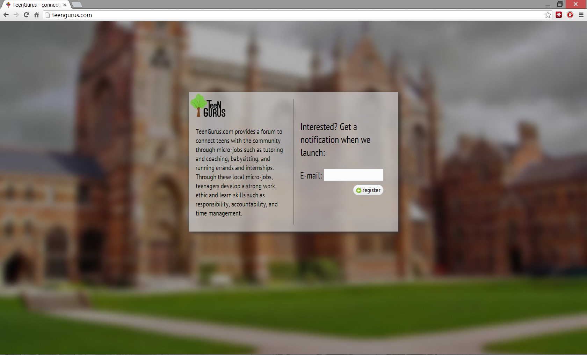

e
e
n
g
u
r
u
s
.
c
o
t
m

Slide 12
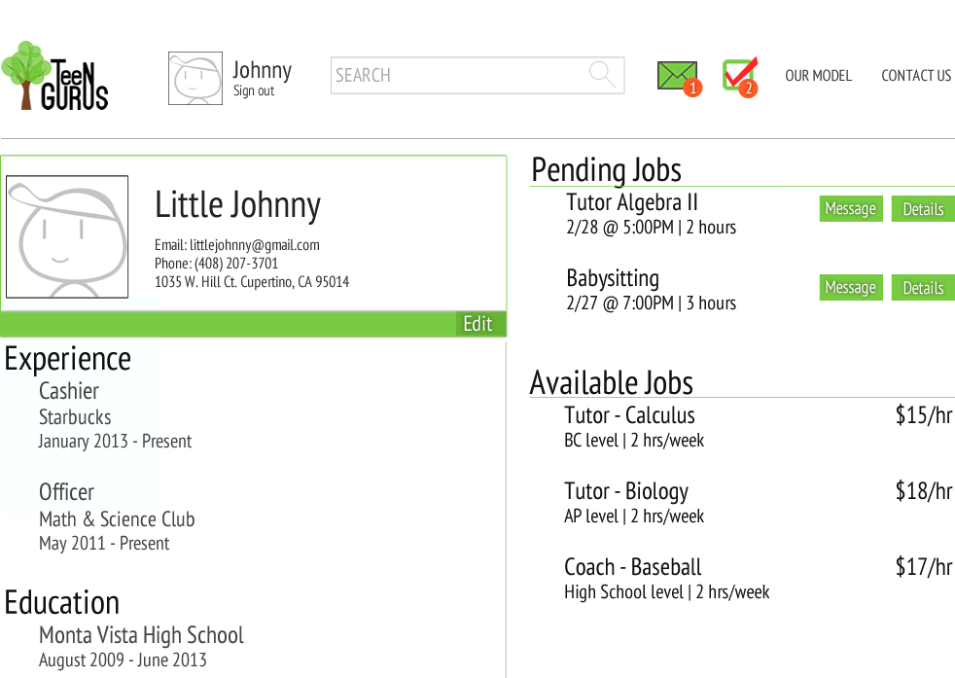
e
e
n
g
u
r
u
s
.
c
o
t
m

Slide 13
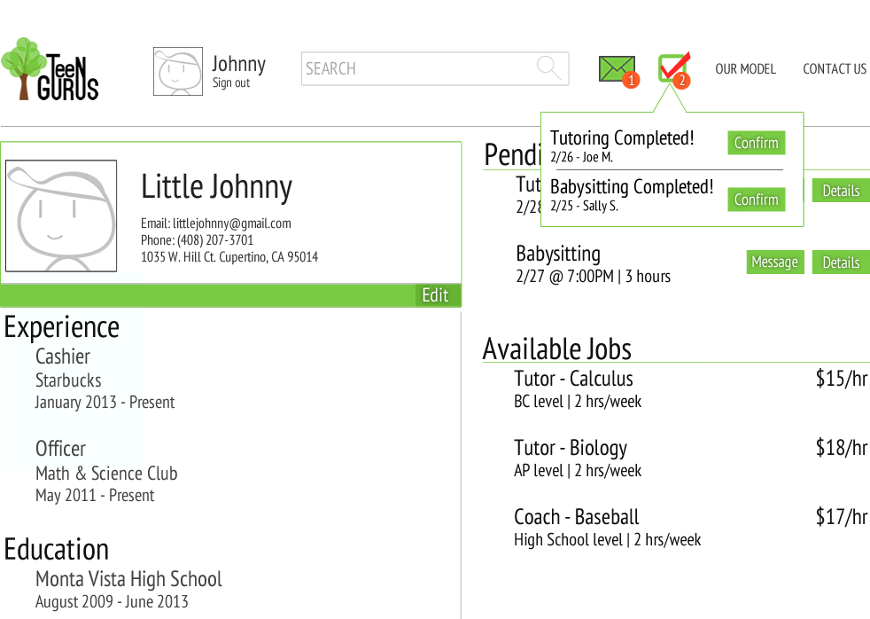
e
e
n
g
u
r
u
s
.
c
o
t
m

Slide 14

~20%
$
$
$
$
Employer
Little Johnny

Slide 15
Silicon Valley
Cupertino
Monta Vista
2
5
9
Month:

Slide 16
Board of Advisors:
Carl Schmidt
Matthew Mahood
Cindy Chavez
Paul Law Group
CEO
Vivek Raghuram
VP of Engineering
Anirudh Kunaparaju
Engineering
CMO
Shailee Samar
Marketing Team
Teen Development

Slide 17
WEAKNESSES
Start-up capital
Small
STRENGTHS
Easy to use
Community
Strong Team
OPPORTUNITIES
Large Market
Scalable
Standard for teen jobs
THREATS
Liability Issues
Larger competitors

Slide 18
Year One Expenses

Slide 22
S30,000
38% Ownership Stake in the Company

Slide 23
$30,000
Acquisition
$32,800,000
109,500%
Managerial Buyout
$2,200,000
7,300%

Slide 24

Vivek Raghuram (CEO)
vivek.raghuram@teengurus.com
(408) 207-3701
Shailee Samar (CMO)
shailee.samar@teengurus.com
(408) 759-1302

Slide 25
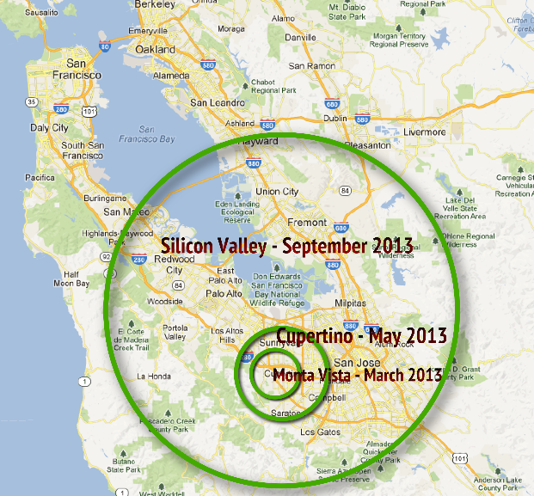
Target Market
Teens
Ages 14-18
Employers
Primary
Families/Parents
Employers
Secondary
Local businesses, larger businesses and community organizations
High school students
Desire work experience/ money
High disposable income and value of education
Strong sense of community
Require extra labor
Lack resources to find help

Slide 26
Target Market
Cupertino
58,000 people
Silicon Valley
256,000 teens
4000 high school students
Median Income - $125,000
450 businesses
2.3 million

Slide 27
63
45%
Survey Results
55%
Respondents
12%
Male
Margin of Error
Female
$36
Average Tutor Price
Per hour
$12
Acceptable Salary
Per hour
4
Acceptable Hours
Per week

Slide 28

Pricing Model
 | 0-10 hours | 10-20 hours | 20+ hours
Teens Payment | 70% | 75% | 80%
TeenGurus Commission | 30% | 25% | 20%
Employer
Teen

Slide 29
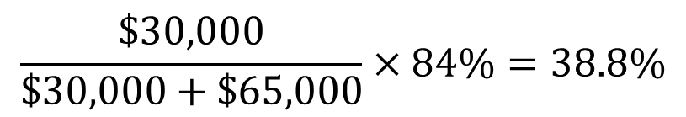
Ownership
16%Allocated for other contributors
$$\frac{\$30,000}{\$30,000+\$65,000}×84\%=38.8\%$$
Sweat Equity

Slide 30
Revenue
 | Month 2 | Month 3 | Month 5 | Month 10
Target # Teens | 50 | 150 | 575 | 2700
$12 per hour
hours per week 3
50% success rate
Commission 20%
U = 9.5787t ^{2.479} R² = 0.9977

Slide 31
Return on Investment
Acquisition
Based of projected 3 year profit
Industry Multiplier
ValueLine
Valmetrics
P/E Ratio
109,500% Return
Managerial Buyout
Based off projected 3 year balance sheet
Funded by other investors
7,300% Return
$$14.1×\$6,130,969=\$86,446,660$$
$$38\% ×\$5,763,415=\$2,190,097$$
$$38\% ×\$86,446,660=\$32,849,731$$

